Slide 1






OxCIN Pride Stall
Theme: Recruiting Participants – How can we do better for inclusivity?
We’ll be hosting an outreach stall featuring inclusive research practices, current studies, and engaging science-themed public involvement activities. Send us your study to promote it!
We’re looking for volunteers to join us at the stall – just for 1 or 2 hours anytime between 10am–6pm. Please contact: juju.fars@ndcn.ox.ac.uk
Date: Saturday 7th June
Time: 10:00am–7pm (come any time)
Location: Oxford South Park

Slide 2

OxCIN Pride quiz
The Pride quiz is back this year!
Join us for a fun, inclusive late afternoon quiz with catering provided!
All are welcome!
To win? Some goodies and Lush products.
You can come alone or with your team, there should be space for everyone!
Any questions? Please contact: juju.fars@ndcn.ox.ac.uk
Date: Tuesday 10th June
Time: 5:00–7:30pm (quiz: 5:30–7:15pm)
Location: OxCIN FMRIB Building - Kitchen

Slide 3
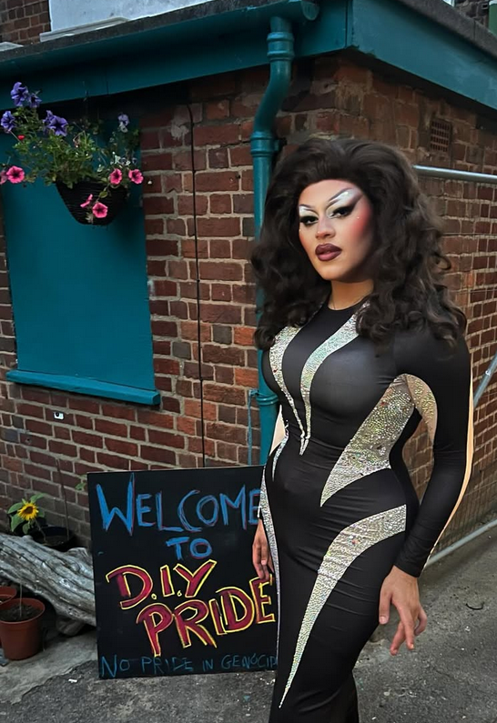


OxCIN Drag Make-up
An interactive session to learn how to shine like a true star from the drag galaxy! Whether you're curious to try drag makeup for the first time or looking to refine your skills, this workshop is for you. We will learn from the best of the best of the Oxfordshire Drag Collective. All genders and experience levels are welcome.
Note: Spaces are limited to 15 participants. Make-up will be available on site but in limited amount, please bring your own kit if you have one.
To book your spot, please contact: juju.fars@ndcn.ox.ac.uk
Date: Friday 13th June
Time: 3:30pm–6pm
Location: OxCIN Annexe – Cowey Rooms
From instagram.com/oxdragcollective/

